Slide 1

COVID-19
Exploring the impacts in Australia
By GROUP 2 – ISHAAN NIGAM, Namita sahoo, Pooja gupta and Sam Portelli

Slide 2
Exploring the impacts of COVID-19 in Australia
How has the Coronavirus (COVID-19) pandemic impacted people, health, businesses, industries and unemployment over the last couple of years in Australia?
This project explores the impacts of COVID-19 in Australia in the following key areas:
Economy/ Business
Unemployment
Health/ People

Slide 3
Scope of the project includes:
Extracting data available for Australia – Primary data resources are
Australian Bureau of Statistics
Reserve Bank of Australia
Australian Institute of Health and Welfare, NSW Ministry of Health and Coroner’s Court of Victoria
World Health organisation
Preparing and Cleaning extracted data for the analysis
Trimming to remove report headers and comments
Formatting into usable time series (Yearly, Quarterly, Monthly, Weekly)
Merging COVID-19 Infection cases and Key measures for correlation analysis
Analysing data for impacts of COVID-19 in key areas identified
Visualising our analysis and summarizing the findings
Plotting charts/ graphs (Bar, Pie, Line, Scatter, Boxplot, Line Regression, Correlation tests) using Matplotlib libraries

Slide 4
Hypotheses of the project includes:
We expected to see an overall change and possible impacts in the following due to the pandemic.
Health:
Increased reported cases of suicides,
Increased use of crisis hotlines and
Increase in deaths
Unemployment:
Increased unemployment rates, including youth unemployment rate
Business/ Economy:
Declined GDP and supply chain measures
Negative impact to Australian dollar trade-weighted Index
Decrease in Company Gross Operating Profits

Slide 5

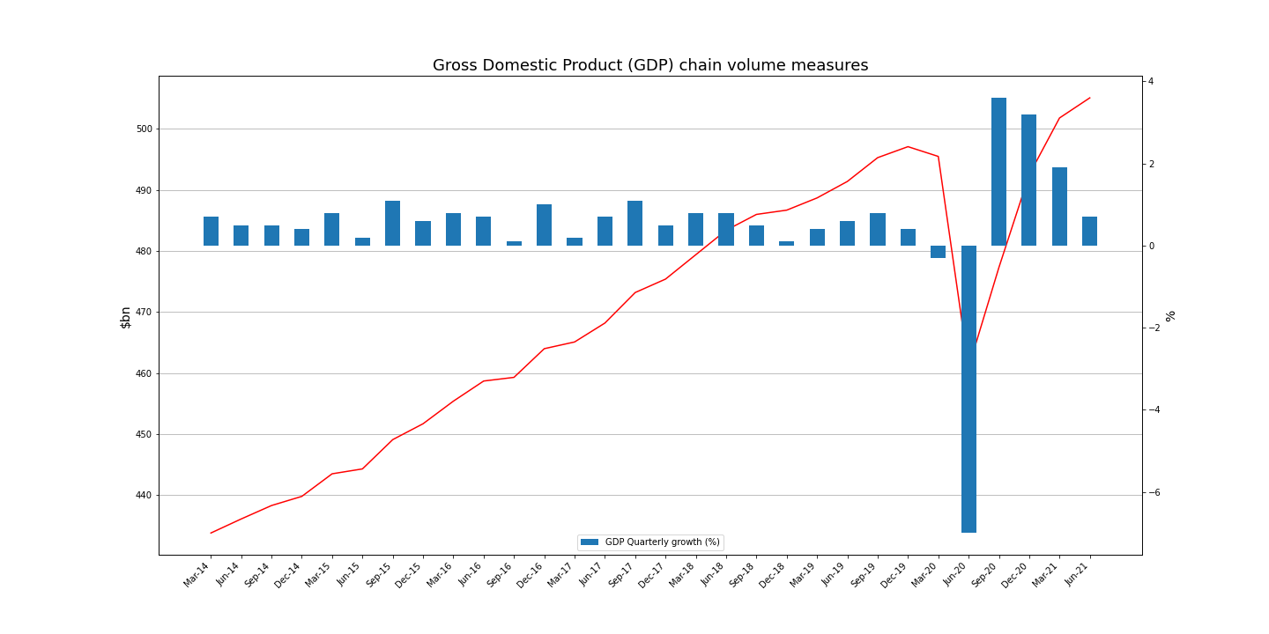
Impacts of COVID-19 on Australian - Business and Economy
Australian economy fell an unprecedented 7.0% in June'20 quarter
GDP fell a historic 7.0% as the COVID-19 pandemic movement restrictions continued to impact economic activity.
This records the first annual estimate of GDP for 2019/20, which fell 0.2%, ending Australia's longest streak of continuous growth, 28 years.
Australian economy rose 0.7% in June'21 quarter
GDP rose 0.7% this quarter, reflecting the continued easing of COVID-19 restrictions and the recovery in the labour market.
The Australian economy grew by 1.4% over 2020-21.

Slide 6
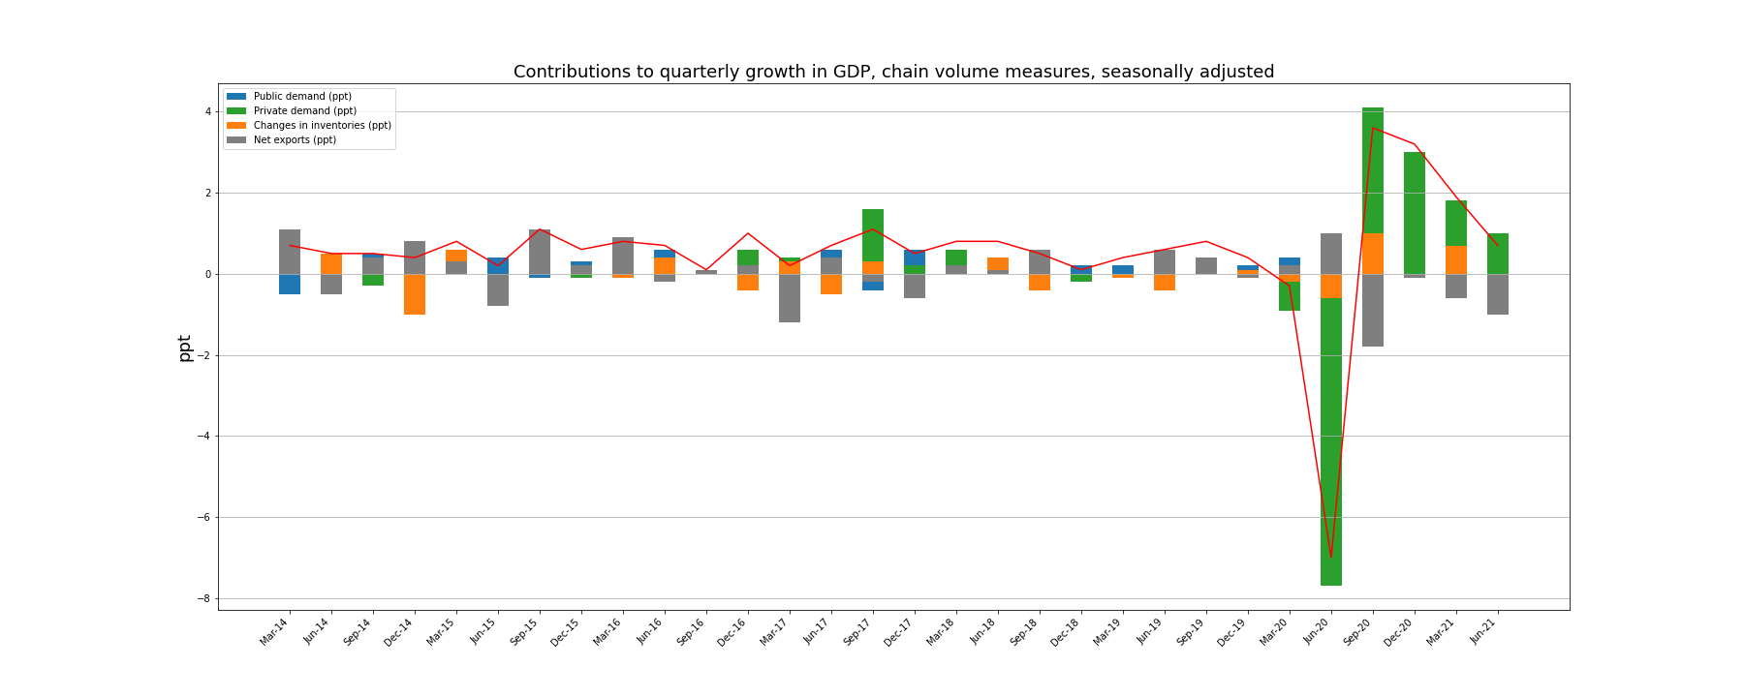
Impacts of COVID-19 on Australian - Business and Economy
Steep decline in Private demand driving the decline of overall GDP during June'20 quarter
Private demand drove the fall detracting 7.9% ppt from GDP, public demand partly offsets the fall, contributing 0.6 ppt, as government increased spending in response to COVID-19.
Domestic demand drives growth during June'21 quarter
The domestic economy drove growth, contributing 1.6 percentage points to the rise in GDP last quarter in June'21. Both private and public demand increased.

Slide 7
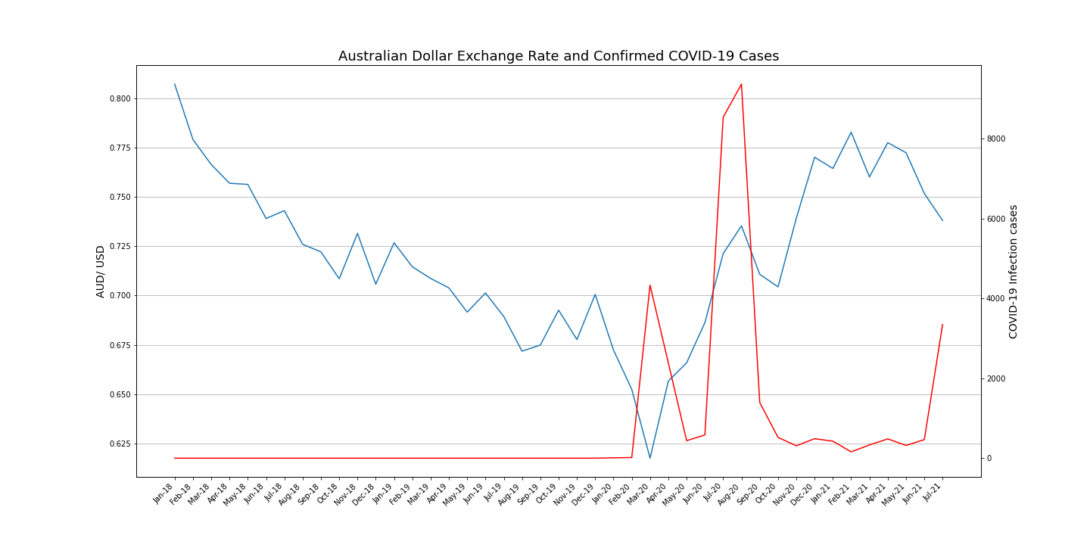
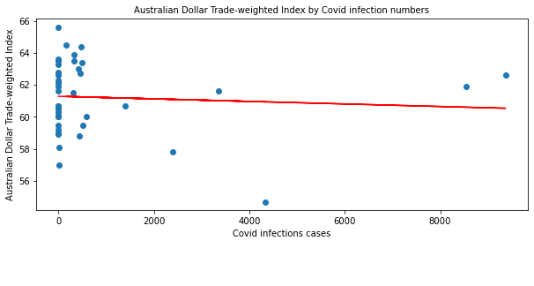
Impacts of COVID-19 on Australian - Business and Economy
AUD depreciated against the US Dollar to levels not seen before the Global Financial Crisis (GFC) as the confirmed COVID-19 cases started increasing in Australia.
The correlation between covid infections cases and Australian Dollar Trade-weighted Index is -0.07 and shows an overall very slight negative correlation.

Slide 8
Covid-19 impact on the National Unemployment Rate
Hypothesis: Covid-19 and lockdowns had a marginal impact on Australian unemployment rate.

Slide 9
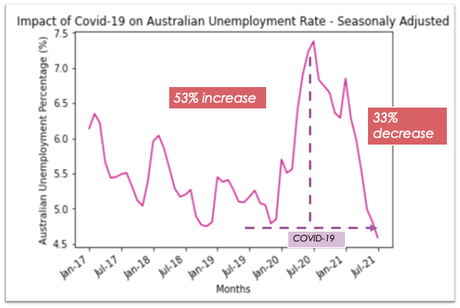
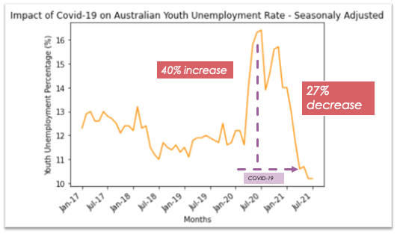
Impacts of COVID-19 on Australian Unemployment
Hypothesis: Hypothesis: Covid-19 increased unemployment rate in Australia.

Slide 10
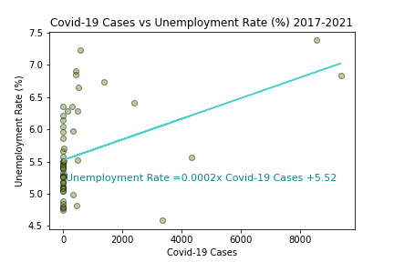
Impacts of COVID-19 on Australian Unemployment
Moderate positive correlation between Covid—19 Cases and Unemployment rate (Correlation coefficient of 0.42)
Summary:
53% increase in Unemployment rate in the month of highest reported Covid-19 cases (July 2020)
40% increase in Youth unemployment rate in the month of the highest reported Covid-19 cases (July 2020)

Slide 11
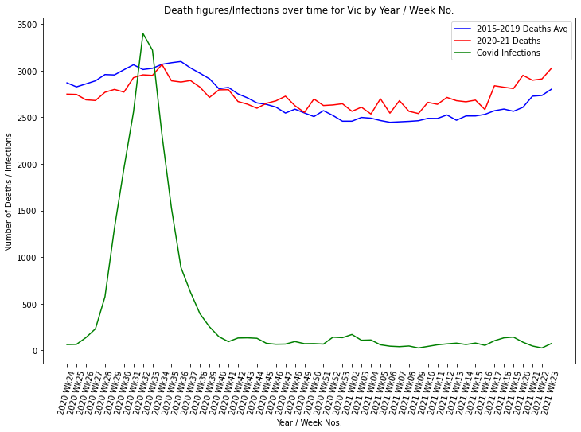
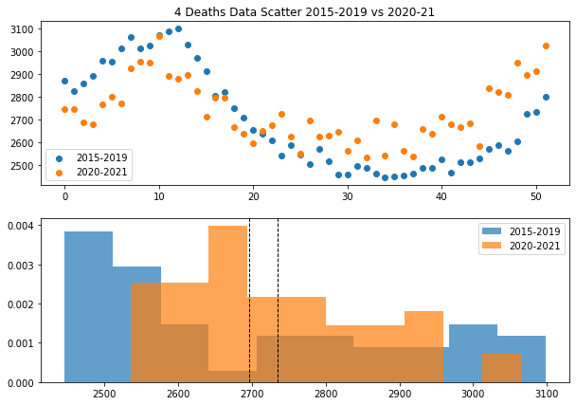
Impacts of COVID-19 on Australian - Health and People
There were a number of interesting observations when comparing deaths by week in 2020-21 with a baseline of 2015-2019 average figures. This showed that during the peak of infections in March/April 2020 and increasing death rates in 2021.

Slide 12
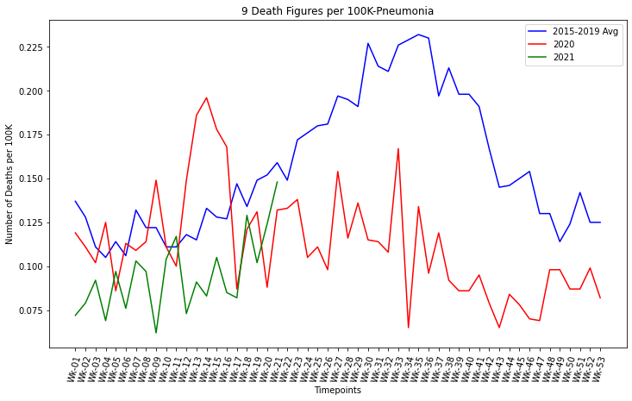
Impacts of COVID-19 on Australian - Health and People
There were a higher deaths, respiratory related deaths i.e. Pneumonia, Dementia/Alsheimers, Diabetes than the 2015-2019 average, but there was a higher than average number of deaths in 2021.
Suicide numbers were at a higher level in NSW than in Victoria. More time, we would investigate this further.

Slide 13
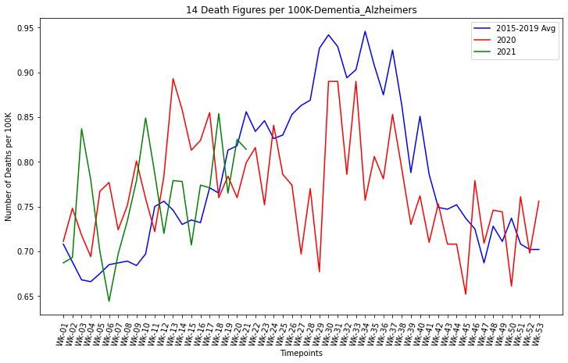
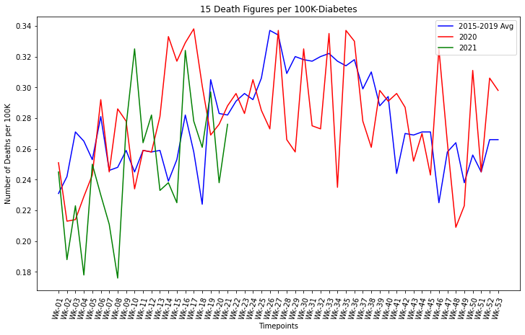
Impacts of COVID-19 on Australian - Health and People
Dementia-Alzheimers & Diabetes Impacts

Slide 14
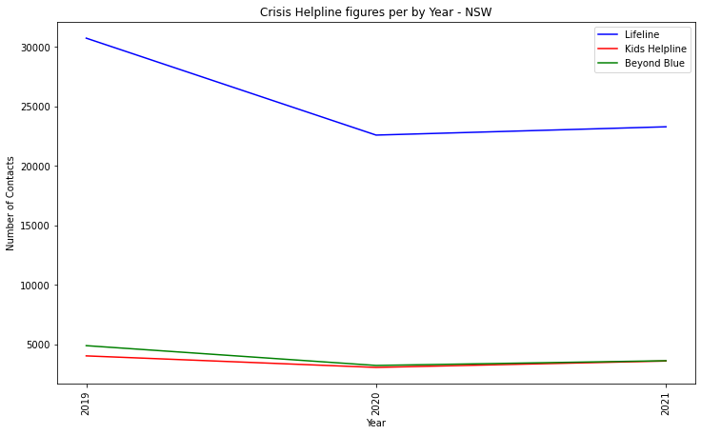
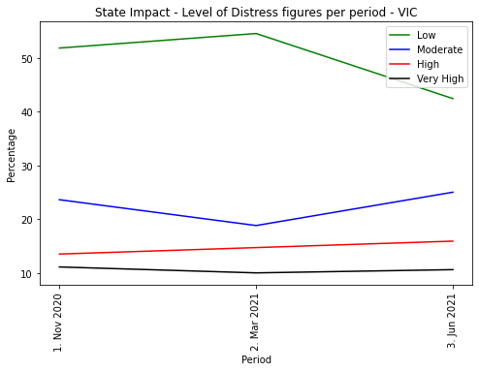
Impacts of COVID-19 on Australian - Health and People
Calls to Crisis helplines such as Lifeline, Kids Helpline and Beyond Blue actually dropped in 2020 and 2021 in comparison to 2019. Perhaps less interaction with people in general, due to isolation, contributed to this decline.
Psychological stress levels as measured by the K10 surveys, has dropped slightly in early 2021 and have increased in the later months in the moderate category. As per the above comment, but as the pandemic continues, it looks apparent that we stress levels are increasing.

Slide 15
Post Mortem
Difficulties and additional questions.
Health:
Unemployment:
Currently seeing a spike in Covid-19 cases again (Vic, NSW). Will need to complete correlation test again later this year to study the impact of Covid-19 from July-December 2021.
Further analysis needs to be conducted to see if political and economic policies introduced in the last two years correlated with the rise/fall of the unemployment rate.
International trade:
Business/ Economy:

